Slide 1



USER FINANCIAL BEHAVIOR ANALYSIS
Technical Test – Data Analyst
Notes:
Welcome everyone. Today, we will walk through our financial behavior analysis project using a decade of user data to uncover key insights for smarter business strategies.

Slide 2


Key Takeaway
Financial behavior segmentation unlocks smarter risk, product, and marketing strategies.
Notes:
This is the core message of our analysis: understanding user behavior enables more effective and targeted decision-making across the company.

Slide 3
Business & Customer Context
Business:
Behavior insights drive product, risk, and marketing.
Customer:
Enables fair treatment & personalization.
Notes:
From the business side, behavior insights drive improvements in product offerings, risk assessments, and marketing efficiency. From the customer perspective, this translates to fairer and more personalized services.

Slide 4

Goals & Impact
Goals
Analyze decade of financial data
Segment by activity, productivity, debt
Enable data-driven decisions
Impact
Proactive risk control
Smarter segmentation
Better strategies
Notes:
Our analysis aimed to profile user behavior and provide actionable insights. The impact spans risk mitigation, smarter product targeting, and informed decision support.

Slide 5

users.csv:
2,000 users
cards.csv:
~6,000 cards
transactions.csv:
~13M rows
Transaction Period:
Data Overview
Jan 2010 – Oct 2019 (2019 incomplete)
Notes:
We worked with three main datasets spanning nearly a decade, capturing over 13 million transactions. This breadth ensures reliable trend analysis.

Slide 6

Workflow Summary
Key Components:
Money fields were cleaned.
Metrics aggregated by user year
Flags were created for debt, productivity, and activity.
Transaction_analysis table is the final dataset.
Notes:
Our data pipeline included preprocessing, yearly aggregation, and logical classification. The result was a clean and usable table for analysis.

Slide 7

SQL Insights
1,200+ active users annually after 2014
97 users spent more than $100,000 annually
781 users never transacted.
Users with a score below 600 have the highest average spending.
Average credit score: male = 710,32; female = 709.17
Notes:
We saw diverse spending behavior, with many users highly active or extremely passive. Interestingly, high spenders often had low credit scores, showing potential risk areas.

Slide 8
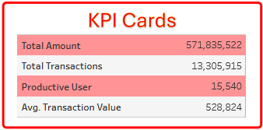
Key Components:
💵 Total Amount: $571.8M
✅ Productive Users: 15,940
🔁 Transactions: 13.3M
💳 Avg Transaction: $528.8
Prepare the Balance Sheet
Notes:
The dashboard provides an overview of scale and behavior. Filters allow flexible exploration by year, user group, and metrics.

Slide 9
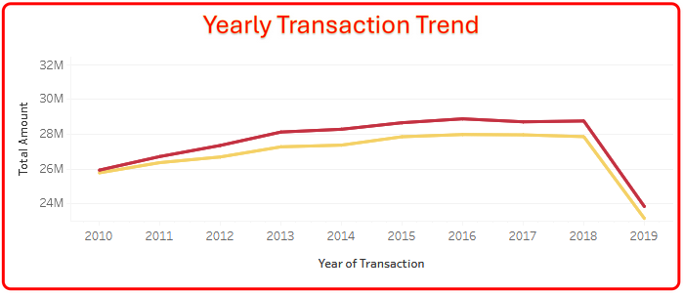
Transaction Trend
Female consistently had higher average spending than Male
Growth from 2010 to 2016
Decline post-2016
2019 drop due to incomplete data
Notes:
Transactions grew until 2016 before dropping off. The dip in 2019 is likely due to incomplete data. Notably, Female consistently spent more than those without Male.

Slide 10
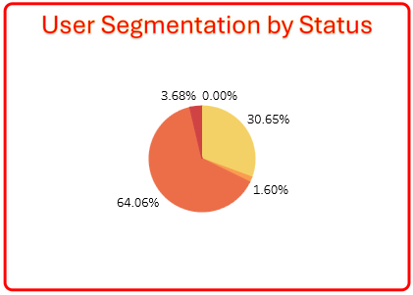
User Segmentation by Total Transaction
64.06%: Active, productive, has debt
30.65%: Active, not productive, has debt
1.6%: Active, not productive, no debt
3.69%: Active, productive, no debt
0%: Not Active
Notes:
A majority of users (64.06%) are active, productive, and in debt, which presents both opportunity and risk for credit products.
Another 30.65% are active but not productive, and still have debt—they might need closer monitoring or support to avoid delinquency.
Only 3.69% are both active and debt-free, a desirable but small segment.
Finally, no users are fully inactive in this dataset, meaning all have shown some form of financial engagement.

Slide 11
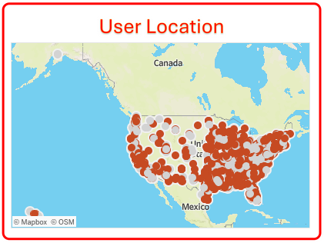
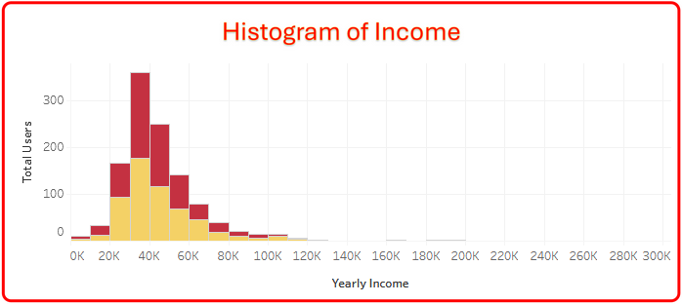
Geography & Income
The majority of active users are centered in the Great Lakes region, NY, and DC in the Eastern United States.
Another noteworthy cluster was discovered in California.
The income distribution is skewed to the right, with the majority earning less than $50,000 annually.
Notes:
We observed two major activity clusters: one in the Eastern US (especially NY and DC), and one in California. Most users fall in lower income brackets, which affects financial behavior and risk tolerance.

Slide 12

Conclusion:
Tableau + SQL = transparent insights
Predictors include income, credit score, and deb
Product and risk strategy are supported by segmentation.
Notes:
In short, this analysis proved that with strong tools and logic, we can derive meaningful insights to support business strategy—especially using segmentation and predictor modeling.

Slide 13
Risk: Alert users with high spending and debt levels
Product: Support borderline users and provide incentives for stability
Marketing: Pay attention to low-risk, productive users
Operations: Expand dataset after 2019 and automate pipeline
Recommendations
Notes:
Our recommendations are tactical: identify risky profiles, reward loyalty, and optimize operations by expanding data and automating the analysis process.

Slide 14




Thank you
+6281272622520
Tangerang, Banten
gtheotista@gmail.com
Notes:
Data without a story is like coffee without sugar—strong, yes, but unappealing. Our goal is to make data memorable, actionable, and human-centered.

